Slide 1
Evaluating Broadband
Subsidy programs
Kristian Olsson & Donovan Cates
Data Science for Public Good 2022

Slide 2
Motivation
Broadband investment is a high priority for the Administration
and Congress
Importance of broadband even more evident in current pandemic
Little research has investigated the economic impacts of broadband programs
The Broadband Initiatives Program (BIP), enacted as part of the American Recovery and Reinvestment Act in 2009, is the largest rural broadband program to date – with an appropriation of $2.5 billion.
Notes:
* $1.8 billion in funding in FY 2018 – 2020 for rural broadband through new ReConnect Program. Several other USDA and FCC programs also promote broadband
* Kandilov and coauthors investigated impacts of the Farm Bill Broadband Loan (FBBL) program on various economic outcomes prior to 2010 in several papers (Kandilov and Renkow 2010; Kandilov et al. 2017; Kandilov and Renkow 2020). Kandilov & Renkow (2020) also examined impacts of the Community Connect Grant program prior to 2010.
* Dinterman and Renkow (2017) investigated impacts of the FBBL program on number of broadband providers, also prior to 2010

Slide 3
Goal
The purpose of this study is to devise novel statistical methodology that allow for program evaluation for BIP as well as other broadband initiatives such as Community Connect and ReConnect.

Slide 4
Literature Review
•Prior studies on impact of broadband on housing prices
• Molnar et al., 2019
• Conley & Whitacre, 2020
•Prior studies implementing Spatial Discontinuity Design
•The Effect of Seismic Hazard Risk Information on Property Prices (Hidano et al., 2015)
•Geographic Boundaries as Regression Discontinuities (Keele & Titiunik, 2015)
•Bayesian Wombling
• Banerjee & Gelfand, 2012

Slide 5
Hedonic Regression Model
Property Value = α + β₁x₁ + β₂x₂ + β₃x₃ + … + ϵ
Analyze the effects of improved broadband access with assessed property value as the variable of interest
Compare to results found when using sale prices
Modeling the house prices using an approximate hierarchical Bayesian spatial model (Datta et. al. 2016, Rue et. al. 2009)
  Featuring an off-the-shelf inference for difference-in-difference estimators
Posterior surface analysis is performed for studying impacts using
    Regression Discontinuity Analysis
    Gradient Assessment

Slide 6
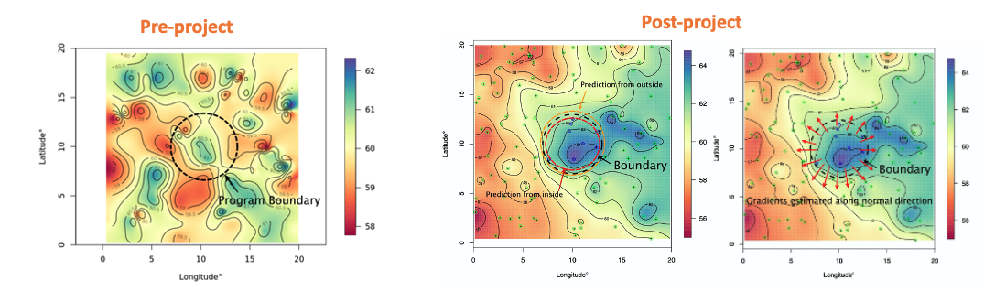
Posterior Surface Analysis
We compare the estimated spatial surface for house prices across the program boundary before and after program implementation.
A steep gradient or sharp discontinuity in the surface is evidence of rapid change at the RUS boundary.
Notes:
•Prior work on this project has utilized the sale value of homes as pre and post broadband program implementation to assess the impacts of broadband improvement

Slide 7
Data Sources
Data sources that help capture effect of broadband
    CoreLogic
      Assessed Property Values
      Housing Characteristics
    Ookla Data
      Internet Speeds
    RUS Program boundary and associated shapefiles
      Allows for comparison between nearby programs on different sides of the broadband project boundaries
Notes:
Datta, Abhirup, et al. "Hierarchical nearest-neighbor Gaussian process models for large geostatistical datasets." Journal of the American Statistical Association 111.514 (2016): 800-812.
Rue, Håvard, Sara Martino, and Nicolas Chopin. "Approximate Bayesian inference for latent Gaussian models by using integrated nested Laplace approximations." Journal of the royal statistical society: Series b (statistical methodology) 71.2 (2009): 319-392.
Womble, William H. "Differential systematics." Science 114.2961 (1951): 315-322.

Slide 8
Model
Model Variables
Data
Data Source
Model Process
Hedonic Regression Model of Property Prices
Covariate
Housing characteristics
Project characteristics
Socio-demographics
Property Sale Value
American Community Survey
RUS Program Shape Files
CoreLogic
Notes:
· Using the data sources and methods described by Donovan, we can begin to create our hedonic regression model and here we present a visualization of the whole process
· Corelogic provides housing attributes (property id code, longitude, latitude, building value, land size, number of bedrooms and bathrooms) and property value
· RUS program files are shape files that shows county borders in R in a visual format that can be used to create the boundaries for the regression of where rural investments were implemented or not implemented
· Finally the American Community Suvery data shows the sociodemographics – mainly showing which areas are considered rural/urban by the ACS
Approach 1: Combine data and perform a hedonic regression analysis using OLS
The Difference in Difference (DID) estimate was recorded for each model, along with its standard deviation.
Following the model fit (DID estimates shown previously), we proceed with posterior surface analysis using Regression Discontinuity Design and Gradient Assessment.
We record the following summaries (at the line segment level):
%ge of discontinuities/gradients significant
Difference in log-house prices (inside vs outside the BIP) (before 2010) and (post (2010): this allows us to check the continuity assumption for DID
Average discontinuity along the BIP boundary
Average Gradient for the BIP boundary for every program area
We compare the estimated spatial surface for house prices across the program boundary before and after program implementation.
A steep gradient or sharp discontinuity in the surface is evidence of rapid change at the RUS boundary.

Slide 9
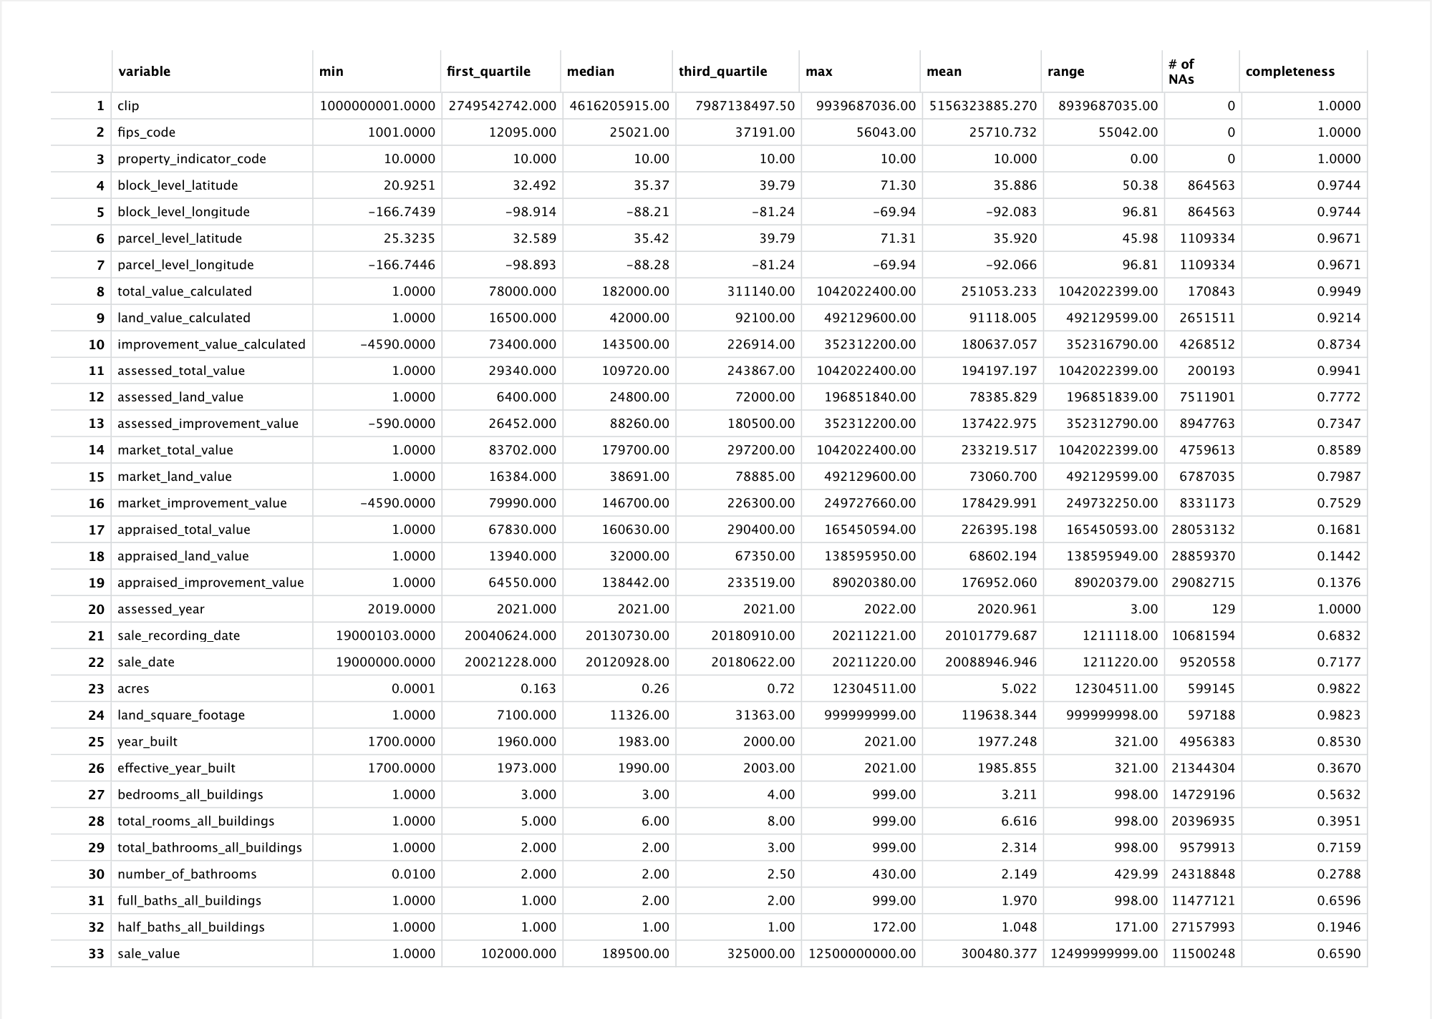
Housing Characteristics EDA
Notes:
· For the corelogic data on housing characteristics, we conducted exploratory analysis using R file to look through the data and find the five number summary, mean, range, number of empty values and the percent completeness of the data

Slide 10
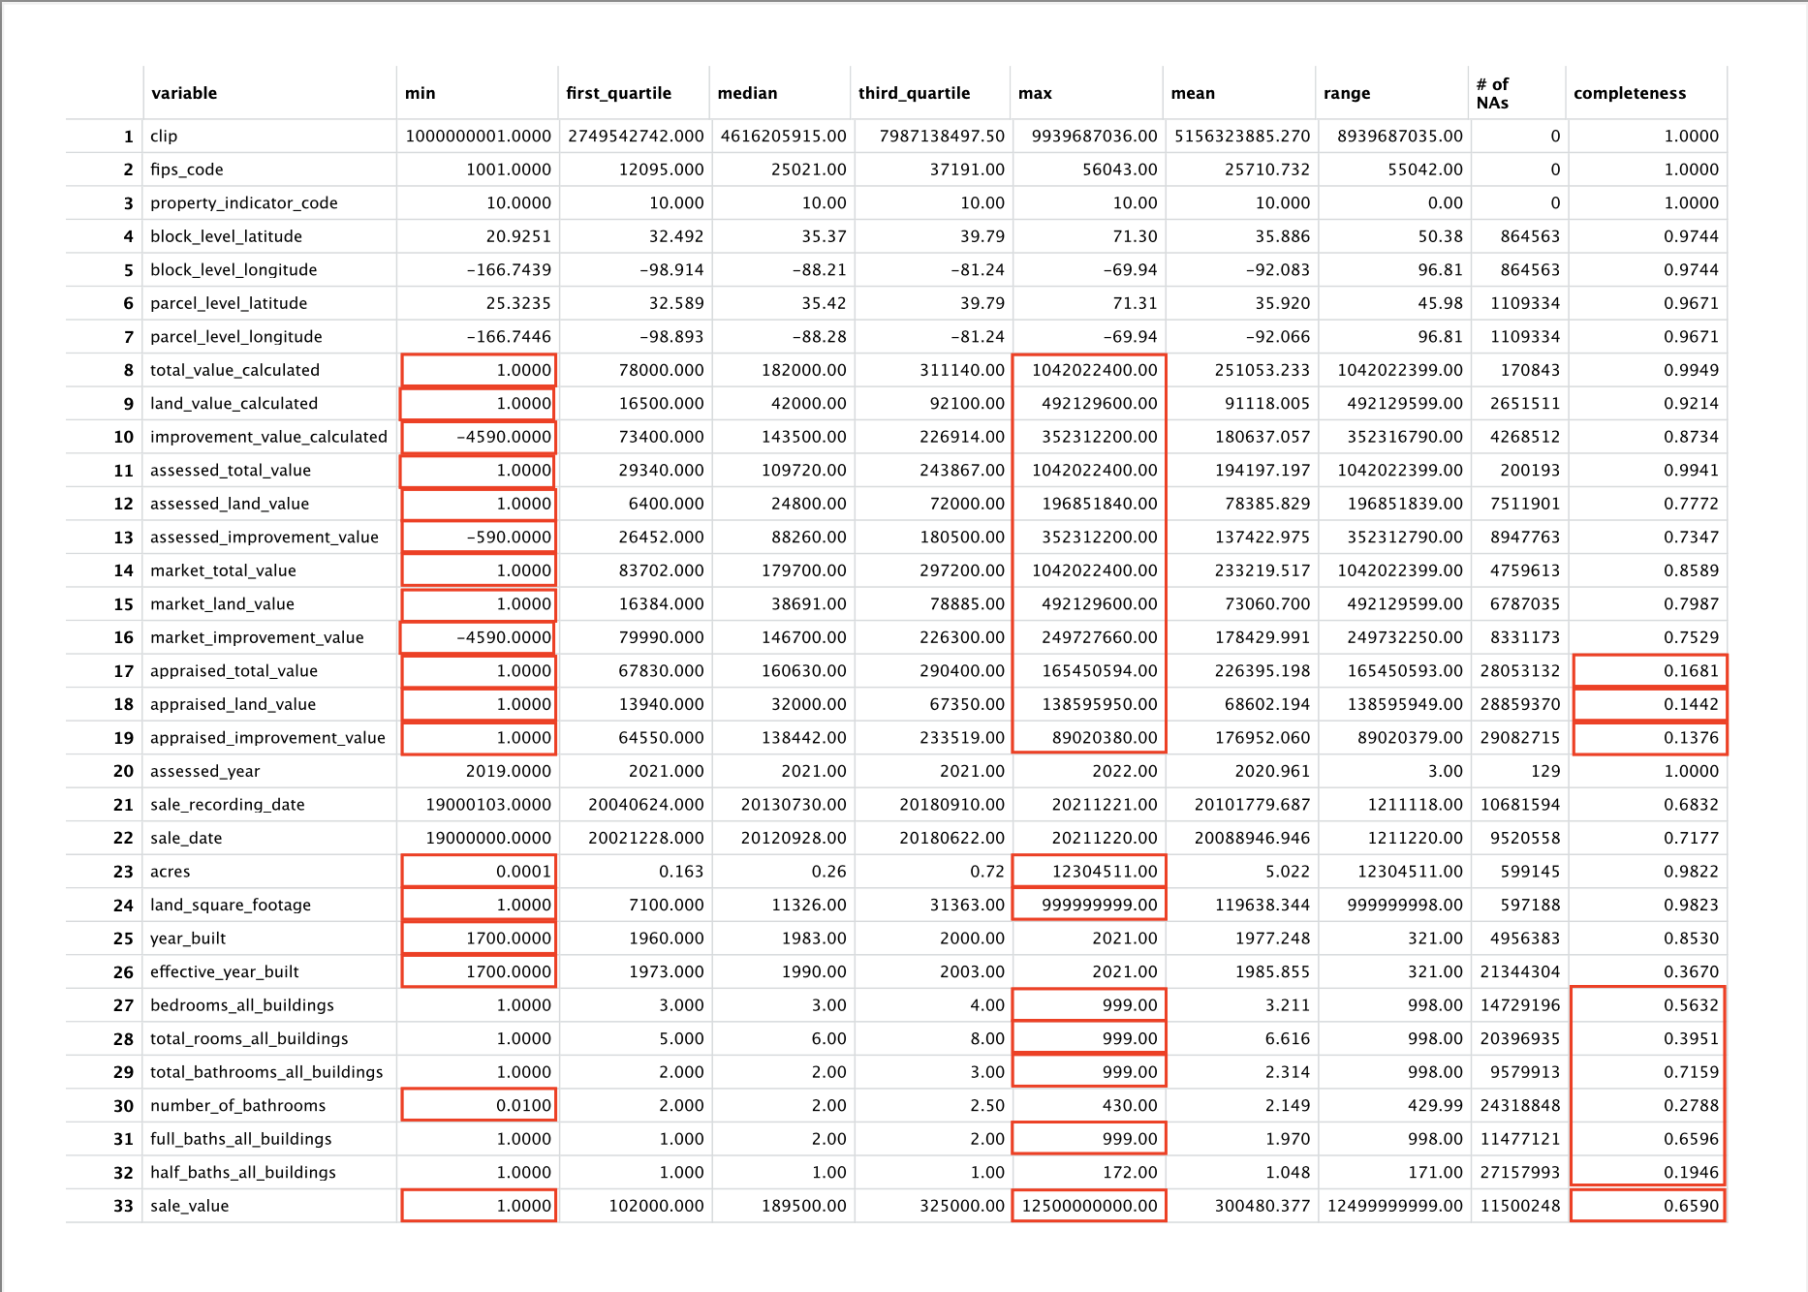
Housing Characteristics EDA
Notes:
· In particular we paid looked through this to find any suspicious values such a values that are
· · too high like a home value of over a billion dollar and a bedrooms count of 999 within a single residence
· · Too low such as home value being 1 dollar or land square footage being 1 square foot.
· · And incomplete data such as completeness percentages of less than 70%, which will limit the number of data points we can use in our analysis. Ideally we would like to keep as many residences to make our analysis complete

Slide 11
Property Value Variable
Notes:
· Specifically want to look at the completeness values for the home total value and the sale value.
· As Donovan described, we were initially going to use sale value, but many of this data were missing and innacurate because some places have never been sold and In addition, some were traded between family members for a price of 1 dollar or in the 1900s for example. In conclusion, the sales data is outdated and likely unreliable.
· Thus we are using the total value calculated which is an home value amount assessed by the local county tax offices on an annual basis, which is 99.5% complete.

Slide 12
Model
Model Variables
Data
Data Source
Model Moving Forward
Hedonic Regression Model of Property Prices
Covariate
Housing characteristics
Project characteristics
Socio-demographics
Property Assessed Value
American Community Survey
RUS Program Shape Files
CoreLogic
Notes:
· Thus we will be using the assessed value in our hedonic model rather than the sale value

Slide 13
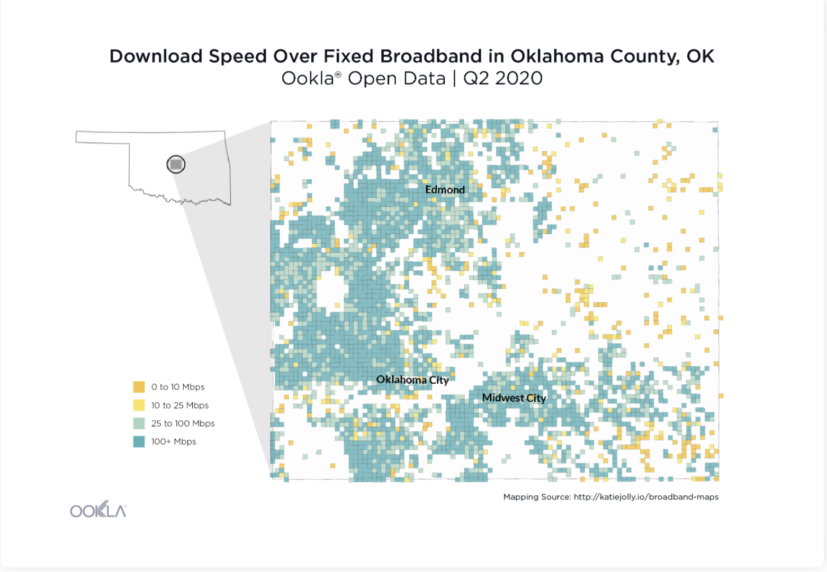
Ookla Data and the ReConnect
Linking the ReConnect program with Ookla Download speed data
600 sq. ms sized grid over which data is recorded
Notes:
· Next, we will do a separate analysis on the Ookla data, which provides information about internet speeds.
· If you’ve ever conducted an internet speed test on your computer, this data would be very similar and measures how long it takes to send and download data, in 600 square meter cubes over the country on a quarterly basis
· In the map above, you can see the different internet speeds, where white indicates areas that havent used internet and yellow representing locations with slower internet connectivity.

Slide 14
Ookla for Program Validation
Model
Data
Data Source
Was broadband supplied to the program areas or not?
Download speeds
Ookla data
RUS Program Shape Files
Program boundaries
Notes:
· Using this data, we can state whether the broadband programs were actually successful in supplying broadband infrastructure to the program areas
· This can also provide details on areas to focus on in the future

Slide 15
Next Steps
Housing Characteristics Data
Clean and interpret data
County-level analysis
Create a hedonic regression model for a specific county that can then be applied to any county
Implementing Ookla Data
Ensure that broadband initiatives are correlated with improved broadband rates in project areas
Notes:
· For next steps,
· We will look into the housing characteristics that we conducted exploratory analysis on and interpret the values and figure out how we can clean the dataset
· Create a hedonic model for a specific county that can then be extrapolated and used for other counties
· Finally, we will use the Ookla data to see ifthe broadband initiatives have actually improved broadband in project areas
Thank you for listening and we will take any questions

